Slide 1
Amateurs and Contemporary Dance: Who? Where? When? What for?
50th World Congress of Dance Research, Athens, 5-9 July 2017
Michel Briand
Université de Poitiers, France
michel.briand@univ-poitiers.fr

Slide 2
In connection with the recent publication of M. Briand (éd.), Corps (in)croyables. Pratiques amateur en danse contemporaine, Centre national de la Danse, Pantin, 2017 http://www.cnd.fr/patrimoine_ressources/corps_incroyables), this presentation analyses various types of amateurs in contemporary dance, through the semantic, aesthetic, and cultural study of fluid categories and typical examples.
1. General perspective
2. Typical features of amateur dancers:
- who? – where and when? – what for?
3. For a non-binary typology of amateurs.
Family resemblances, prototypes and fuzzy sets

Slide 3
General perspective:
The so-called “amateurs” in contemporary dance present diverse and even sometimes contradictory aspects. They both intensify and disrupt the notions of choreographic work, creation, transmission, experience, and expertise. They move and transform aesthetic, ethical, and political norms and categories which contemporary dance spectacles and practices refer to. From expressionist moving choruses to post-modern experimental performances, as the body of un-professional / amateur dancers may considerably vary in age, gender, or ethnical, social, and cultural affiliations, it may be at once ordinary, neither virtuoso nor spectacular, but filled with human presence, and extraordinary, surprising, a witness of “something different”. The variegated fragility of amateurs and their tentative definitions call in question the very ideas of dance, spectacle, and contemporaneity.

Slide 4
Michel Briand (éd.), Corps (in)croyables. Pratiques amateur en danse contemporaine, Centre national de la Danse, Pantin, 2017

Slide 5
Typical features of amateur dancers
- who? children, teenagers, younger - older adults / female, male, trans-, inter-gender … / straight, gay, queer … / diverse ethnicities, cultural backgrounds, and social classes, all in terms of intersectionality
- where and when? on different kinds of stages, in studios, in town / countryside / natural settings, on the streets, in closed environments (e. g. sanitary, custodial, educational …), in festivals, ballrooms, political meetings and actions … / in diverse periods (from the ancient Greek chorus to contemporary rave parties) and styles (traditional, social, urban dances …), especially when variously connected with contemporary dance, in a stricto sensu definition.
- what for? recreation, leisure, seduction, transe, ritual celebration, show, communication, education, wellness, health, ecology, protest, activism …

Slide 6
For a non-binary typology of amateurs. Family resemblances, prototypes and fuzzy sets 1
spectators / amateurs:
bystanders, onlookers, critics, witnesses, visitors, guided – participating - immersed spectators, e. g. :
Simone Forti, Huddle (1961)
Odile Duboc, Les Fernand)
Olga de Soto, Histoire(s) (2004) about Le Jeune Homme et la Mort (Jean Cocteau / Roland Petit) and Débords (2012, about The Green Table (Kurt Joos)
Jérôme Bel, Cour d’honneur (2013)
Mette Ingvartsen, 69 positions (2014)
Boris Charmatz, Musée de la danse (2009
Tino Sehgal, Carte blanche, Palais de Tokyo, and Création, Opéra de Paris, 2016)

Slide 7
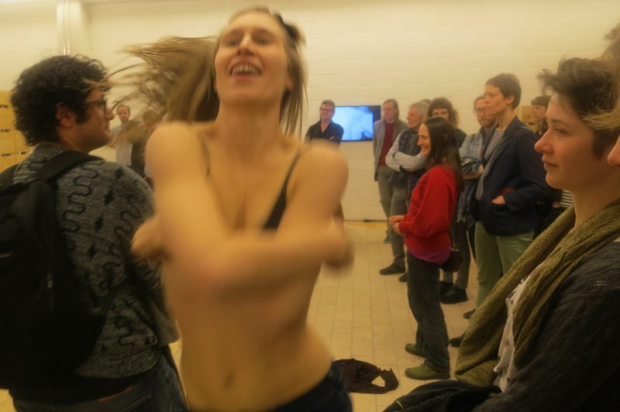
Mette Ingvartsen, 69 positions (2014)
Simone Forti, Huddle, High Line (New York), 2012 (1961)

Slide 8
For a non-binary typology of amateurs. Family resemblances, prototypes and fuzzy sets 2
carnivals, festivals, rituals, communities:
Dionysian dancers (trance and extasis, in traditional rites as well as ballrooms and urban cultures – hip hop, techno …, traditional and street dancers, “other professionals” e. g. :
François Chaignaud and Cecilia Bengolea, esp. (M)imosa, Twenty Looks or Paris is Burning at the Judson Church (M), Danses Libres Le tour du monde des danses urbaines en dix villes …
Ana Borralho and Joâo Galante, Atlas Lisboa, Helsinki, Rio de Janeiro, Milano, Lille, Budapest, Poitiers (2011-) …
Mathilde Monnier / Philippe Katerine, 2006 vallée
Pascale Houbin, Aujourd’hui à deux mains (2009)

Slide 9
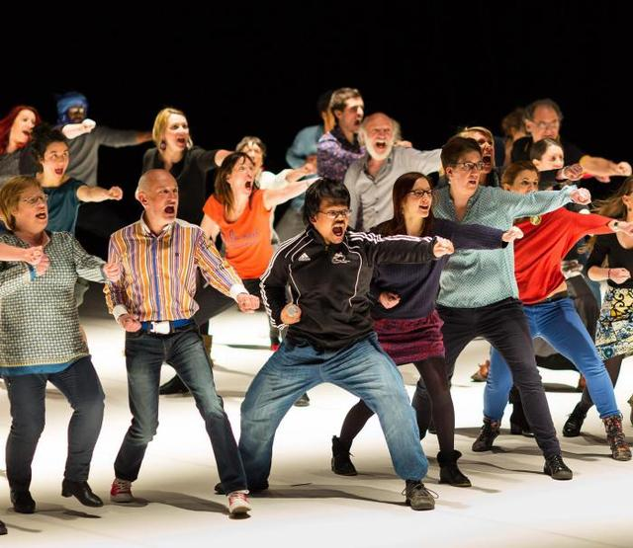
François Chaignaud / Cecilia Bengolea:
Danses Libres (2010)
(M)imosa, Twenty Looks or Paris is Burning at the Judson Church (M) … (2011)
Ana Borralho / Joâo Galante, Atlas Poitiers (2016-)

Slide 10
For a non-binary typology of amateurs. Family resemblances, prototypes and fuzzy sets 3
staged / choreographed amateurs:
“pretending amateurs”, dance students, apprentices – teachers
“embodied archives” (e. g. the project Danse en amateur et répertoire, at the Centre national de la danse)
“precarious galas” (e. g. Eun-Me Ahn, 1’59 Project in We are Koreans, honey!; Jérôme Bel, Gala, 2015)
(inter)generational groups / solos (e. g. Pina Bausch, Kontakthoff, 1978-2000-2008; Eun-Me Ahn, Dancing Teen Teen, Dancing Grandmothers, Dancing Middle-Aged Men; Thierry Thieû Niang … du printemps, 2011; Mickaël Phelippeau, Bi-portraits, 2008, Pour Ethan, 2014; Avec Anastasia, 2015 ) …

Slide 11
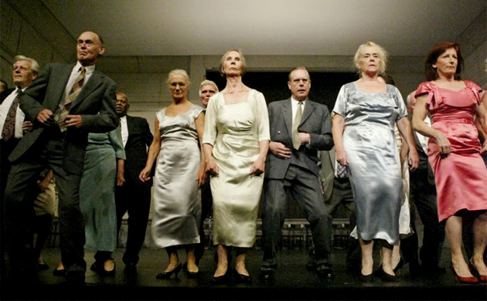
Pina Bausch
Kontakthoff - Mit Damen und Herren ab '65, 2000
Kontakthoff – Mit Teenagern ab 14, 2008 (film by Anne Linsel & Rainer Hoffmann, Tanztraüme, 2010)

Slide 12
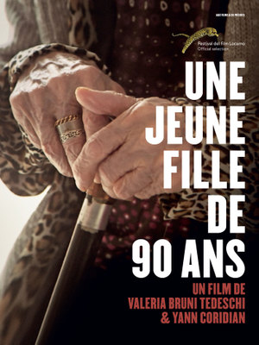
Thierry Thieu Niang in A 90 years young girl (film by V. Bruni-Tedeschi & Y. Coridian, 2017)

Slide 13
For a non-binary typology of amateurs. Family resemblances, prototypes and fuzzy sets 4
“fragile animals” and rebels:
- care and empowerment practices, e. g. :
Anna Halprin (Dancing my Cancer (out of boundaries), 1975; Rocking Seniors, 2005; Planetary Dance, 1987)
Jorge Leon (film Before we go, 2014)
Mathilde Monnier, Bruit blanc (autour de Marie-France), 1998
Odile Azagury, with female prisoners
- rebellions and revolutions (e. g. Femen, Act Up, Occupy Syntagma …)

Slide 14
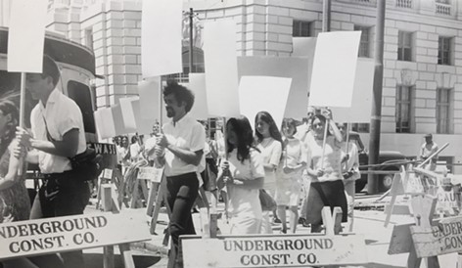
Anna Halprin, Ceremony of us (1969)
Anna Halprin,
Blank Placard Dance
(1967)

Slide 15
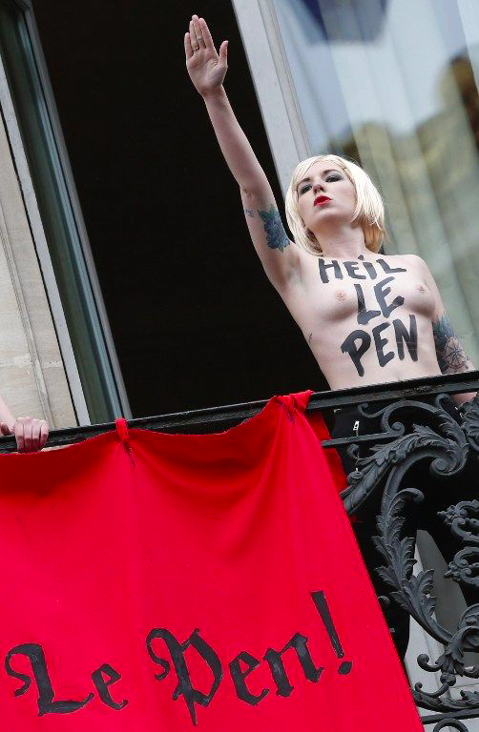
Femen vs. Front National, May 1st 2015, Place de l’Opéra, Paris

Slide 16
Afterword: What do amateurs do to contemporary dance? And to contemporaneity? And to dance?
They make it
(in)credible, (in)actual, (im)patient, (ir)responsible, (in)efficient, (in)active, (in)human, (in)correct, (im)precise, (im)perfect, (in)nocuous, (il)legal, (ir)rational, (in)capable, (in)tangible, (in)dependant, (in)visible, (im)possible, (ir)reverent, (in)curable, (ir)resistible, (in)congruous, (im)maculate, (im)mobile
(un)even, (un)suitable, (un)real, (un)forgettable, (un)just, (un)voluntary, (un)intentional, (un)clear, (un)usual, (un)speakable, (un)bearable, (un)determined, (un)aware, (un)avoidable, (un)balanced, (un)comfortable, (un)expected, (un)familiar, (un)glamorous, (un)healthy, (un)known …

Slide 17
Some bibliographical references:
Michel Briand, « Du contemporain dans la danse contemporaine? Présence, performativité, actualité dans quelques créations trans-modernes (M. Marin, F. Chaignaud, C.Ikeda, O. Dubois) », in C. F. Stock & P. Germain-Thomas (Eds.), Contemporising the past: envisaging the future, WDA Global Summit, Angers, 6–11 July 2014 (http://www.ausdance.org.au)
« Paradoxes of Spectacular/Political Performativity: Dionysiac Dance in Classical Greek Theatre, Olivier Dubois’ Tragédie, the Femen’s Sextremist Protests, and Trajal Harrell’s Antigone SR., in Congress on Research in Dance Conference Proceedings, Cut and Paste : Dance Advocacy in the Age of Austerity (June 4-7 2014, Athens), Cambridge UP, october 2016, p. 27-37,https://www.cambridge.org/core/journals/congress-on-research-in-dance/
« Interplays between Politics and Amateurism : Ritual and Spectacle in Ancient Greece and some Post-modern Experiments (Castellucci, Bagouet, Duboc, Halprin) » (SDHS 2010 Conference, Dance and Spectacle, 8-11 july, Univ. of Surrey, Guilford & The Place, London, UK), http://sdhs.scripts.mit.edu/proceedings/2010/#papers , p. 33-48
Judith Butler & Athena Athanassiou, Dispossession: the Performative in the Political , Polity Press, Cambridge, 2013 et Judith Butler, Notes Toward a Performative Theory of Assembly, Harvard, 2015
Gilles Deleuze & Félix Guattari, « Comment se fait un corps sans organes? », Mille Plateaux, Minuit, 1980
Aurore Desprées, Gestes en éclats. Art, danse et performance, Les Presses du Réel, Besançon, 2016, « Carte de l’ouvrage » en quatre espaces : Notion de performance / Performance et document / Dispositifs, espaces, temps / Corps, gestes, politiques
John Dewey, Art and Experience, Balch, 1934
Barbara Formis, « La performance de la vie », in Lucia Angelino (dir.), Quand le geste fait sens, Éd. Mimêsis, Philosophie, 2015
Siegmund Gerald & Stefan Hölscher (eds.), Dance, Politics & Co-Immunity. Thinking Resistances , Vol. I, diaphanes, Zürich-Berlin, 2013, p. 247-258: Ramsay Burt, « The Biopolitics of Modernist Dance and Suffragette Protest »,
Georges Kleiber, La sémantique du prototype. Catégories et sens lexical, PUF, 1990
Jacques Rancière, Le Spectateur émancipé, La Fabrique, 2008
Paolo Virno, Essai sur la négation. Pour une anthropologie linguistique, L’Éclat, Philosophie imaginaire, 2016, en particulier chap. I « Prologue. Neurone miroirs et faculté de nier », p. 7-20
Joëlle Zask, Art et démocratie : peuples de l’art, PUF, 2003, et Participer : essai sur les formes démocratiques de la participation, Latresne, Le Bord de l’eau, 2011

Slide 18
∞
Thank you for your attention
Merci beaucoup pour votre attention
Σας ευχαριστώ παρά πολύ για την προσοχή σας
∞

