Slide 1
Loie fuller – wizardress of dance
The Art Nouveau Goddess
Presenter Prof Lady Christine Bamford

Slide 2
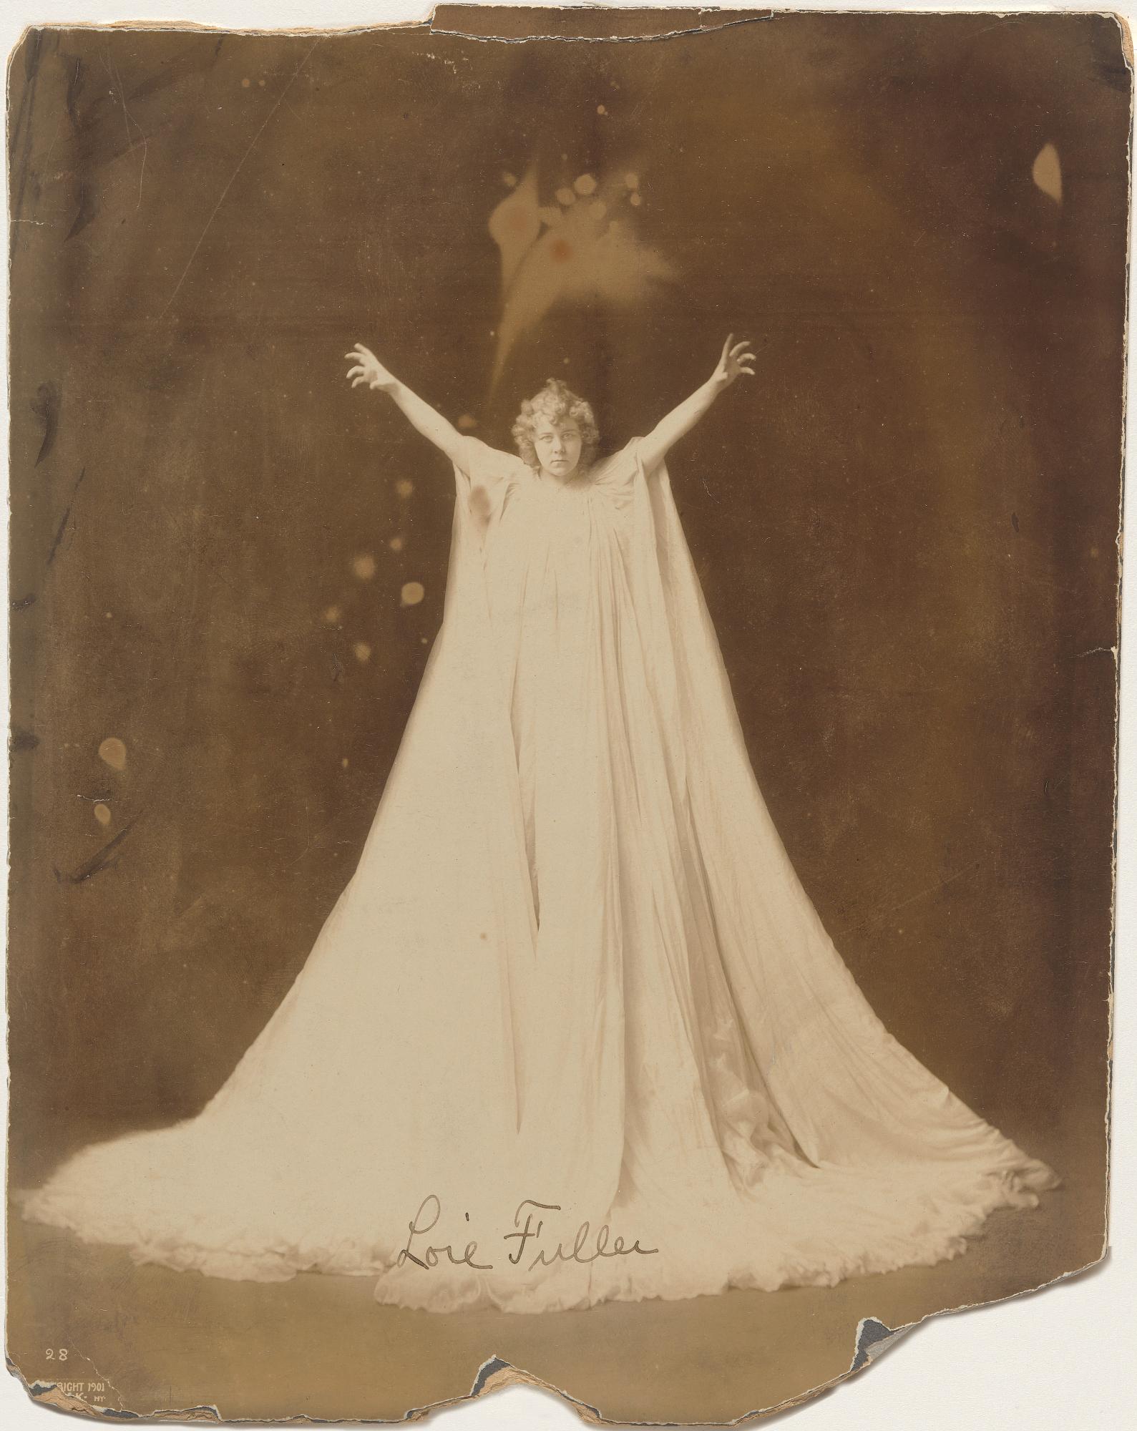
“Loie” ART NEUVEAU GODDESS (1862-1928)

Slide 3
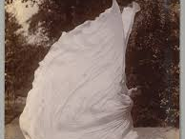
ARTISTRY OF SILKS

Slide 4
Majesty of Movement with silks

Slide 5
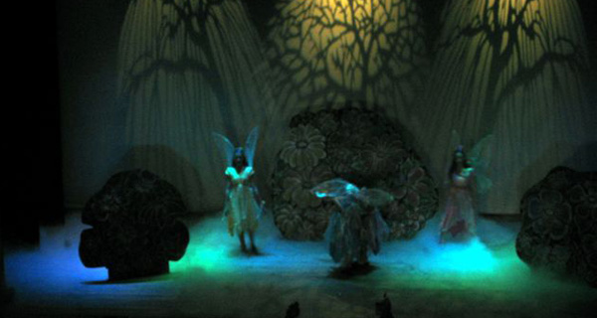
ALCHEMY OF LIGHTS

Slide 6
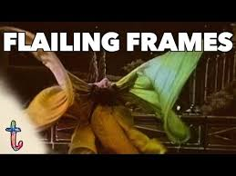
FULLERS PERFORMANCE IN PARIS 1893 considered emblemanic of ART NEAUVEAU ATTEMPT TO LINK ARTISTIC AND TECHNOLOGICAL INTERVENENTION -

Slide 7
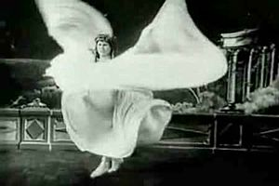
SILENT MOVIES PIONEER SERPENTINE DANCE in 1896

Slide 8
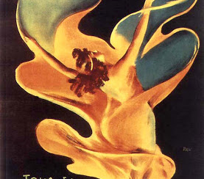
REGULAR ARTIST AT FOLIE BERGERE

Slide 9
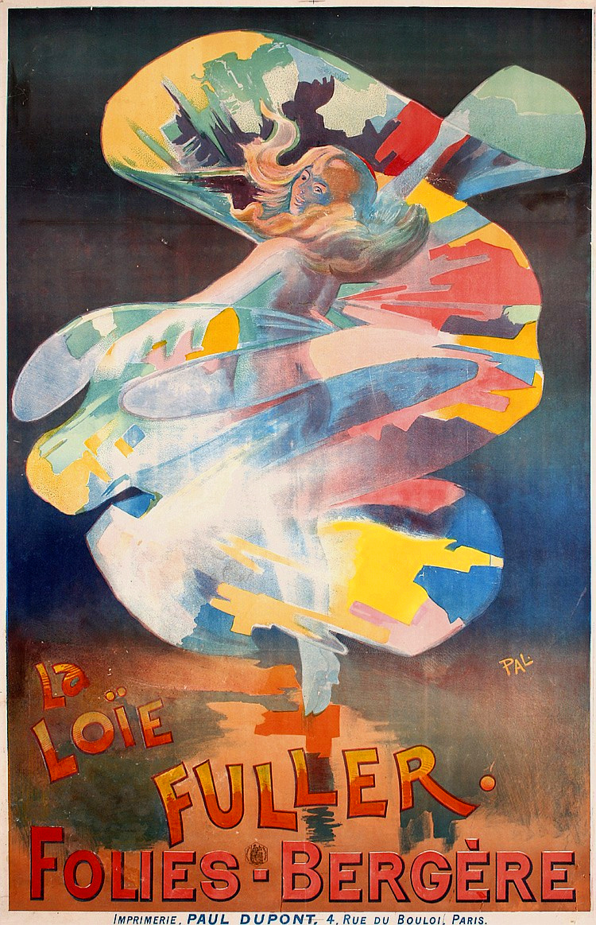
ICONIC POSTER

Slide 10
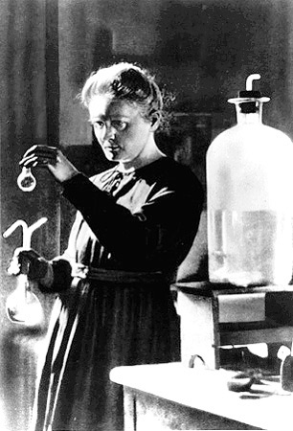
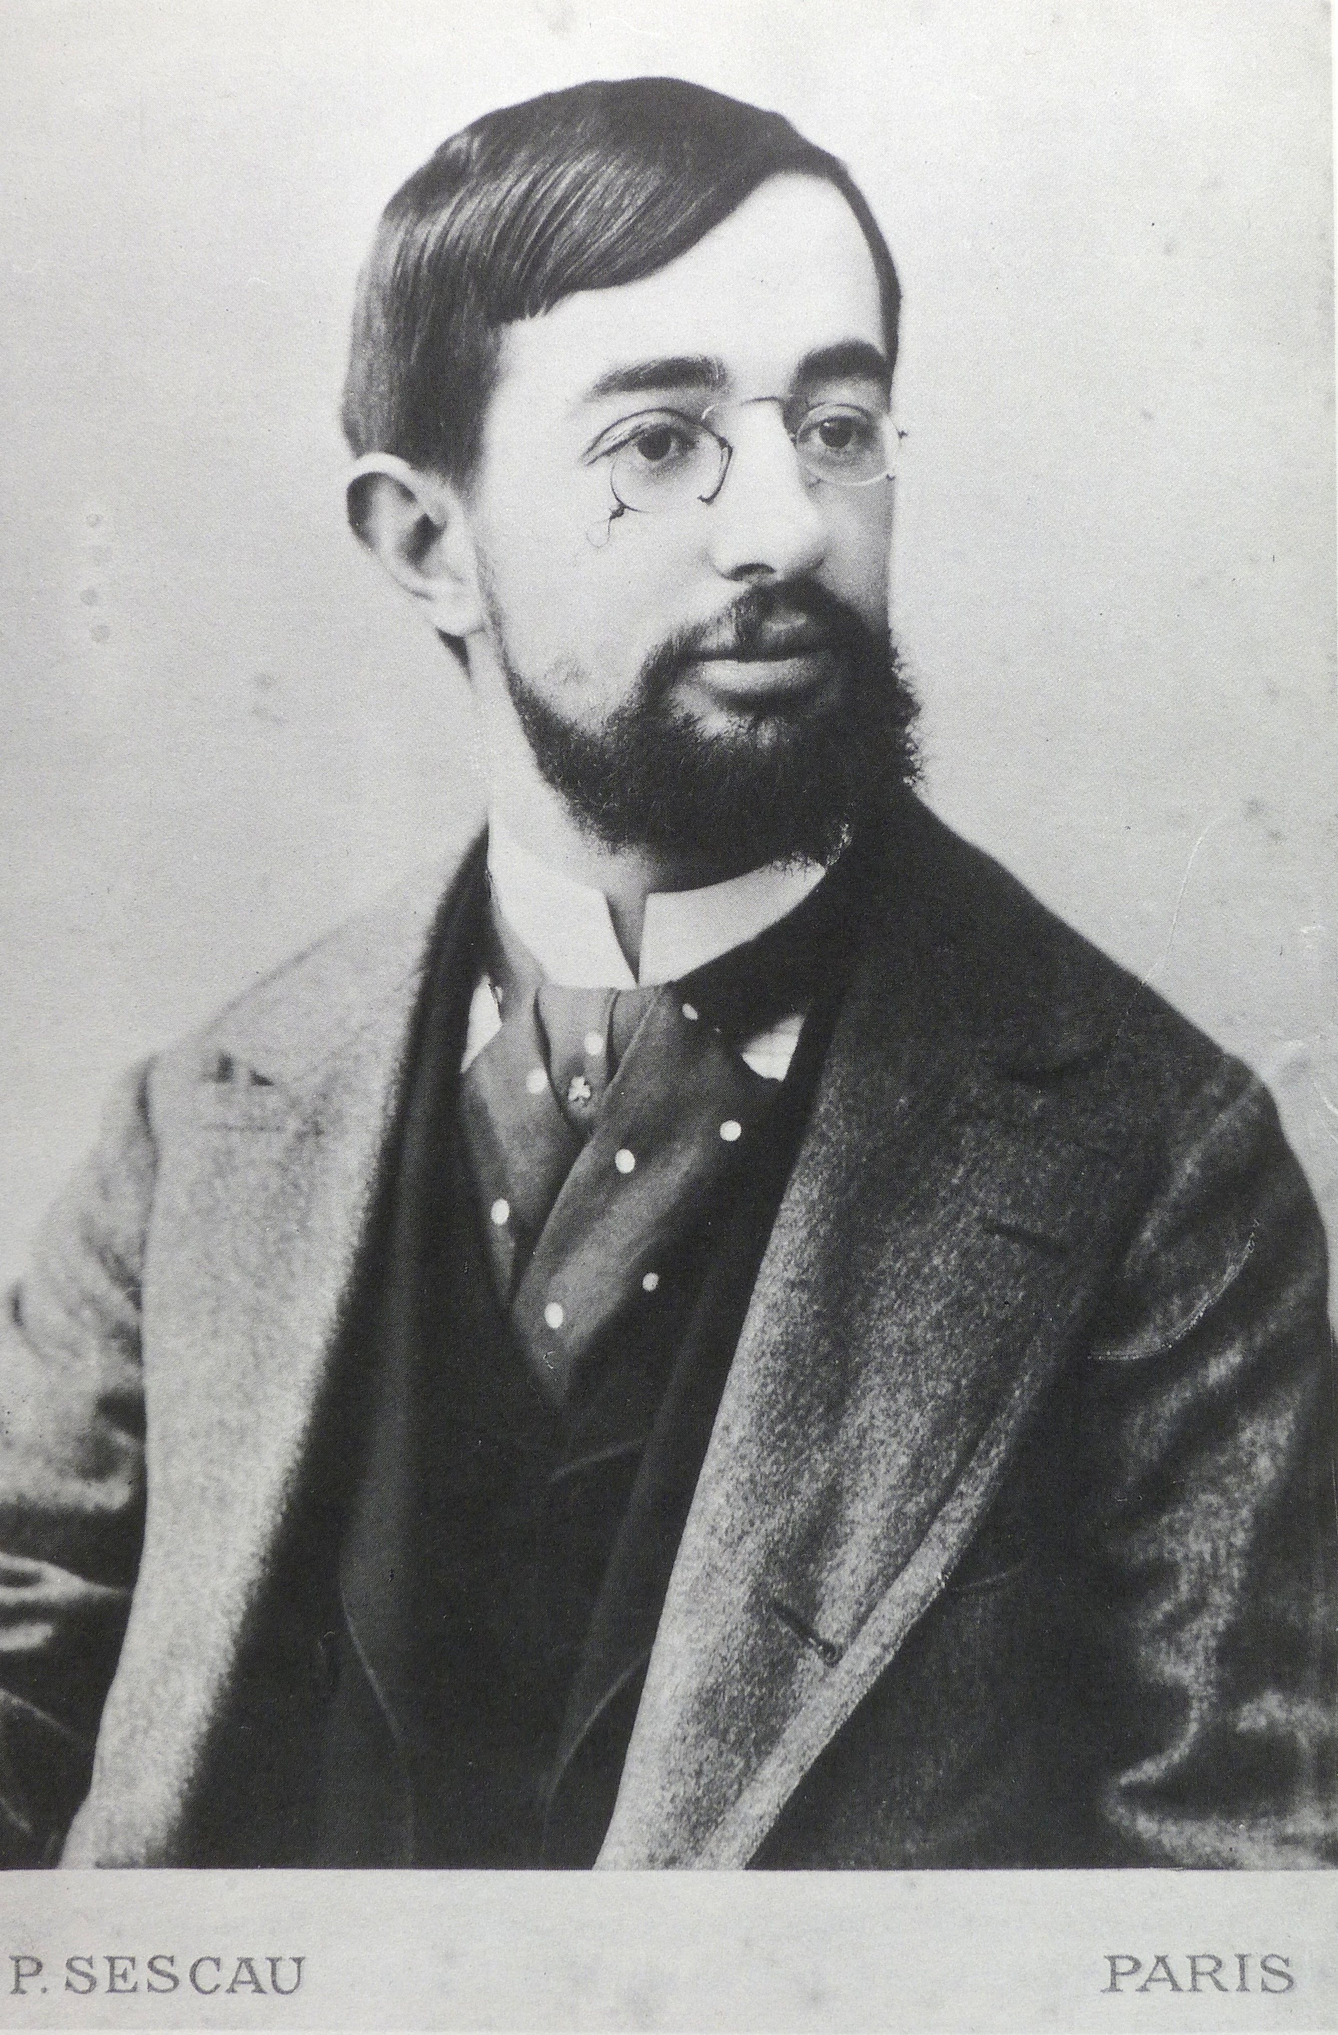
POWERFUL FRIENDS
Toulouse-Lautrec
Marie Curie
Queen Mary of Rumainia

Slide 11
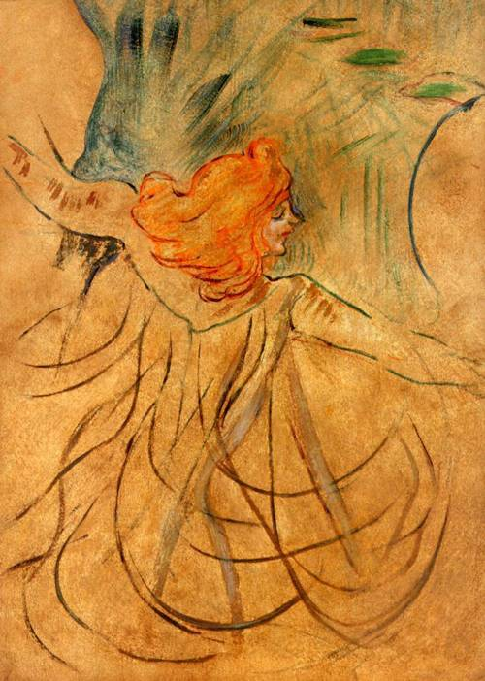
LOIE FULLER PAINTED BY TOULOUSE-LAUTREC

Slide 12
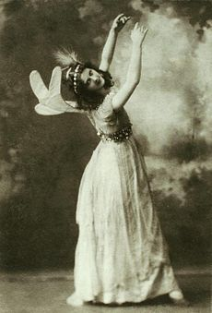
SPONSOR of ISADORA DUNCAN CONCERTS IN VIENNA & BUDEPEST

Slide 13
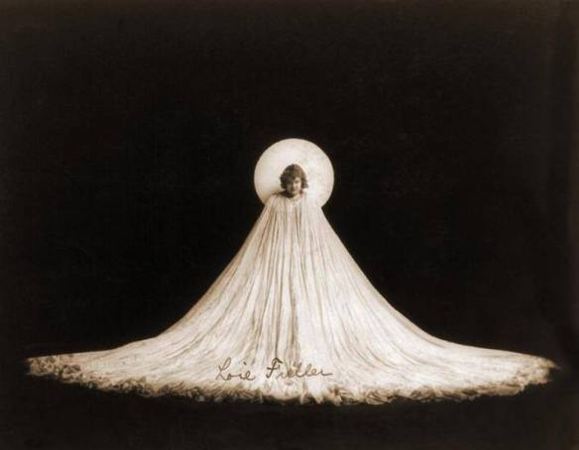

Slide 14
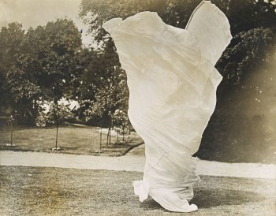
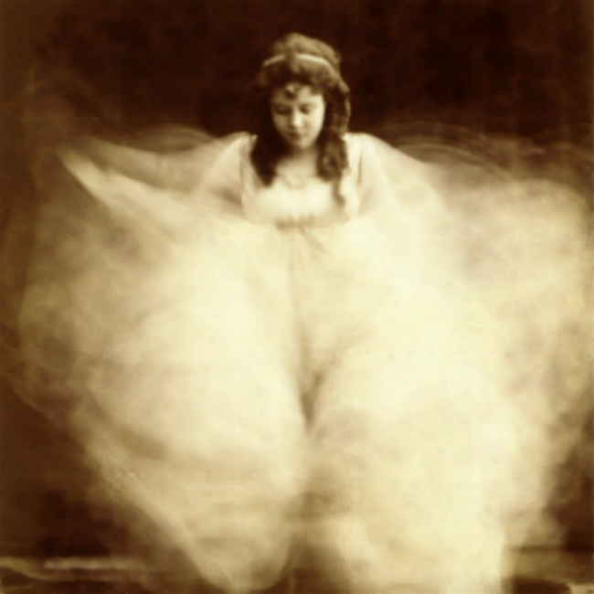
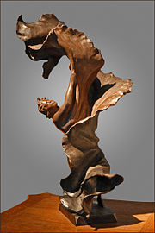
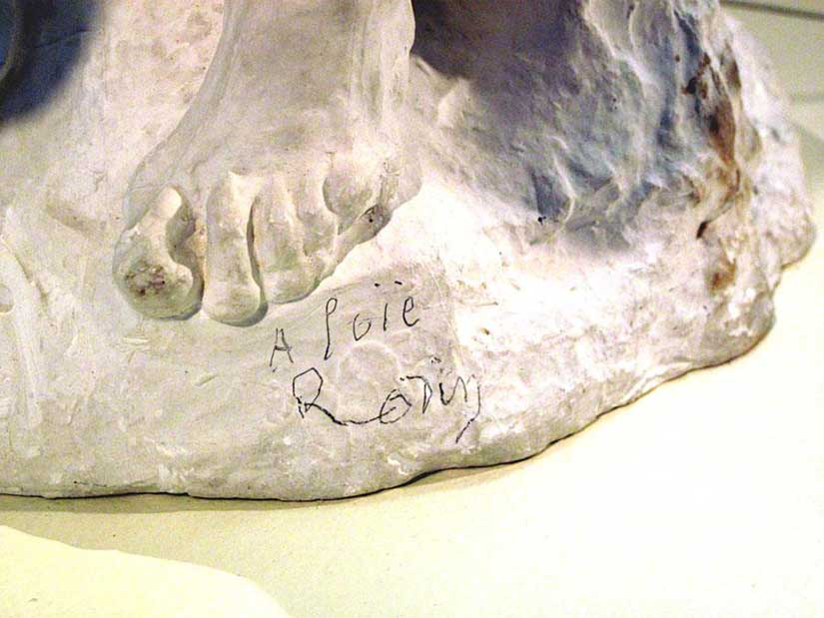

Slide 15
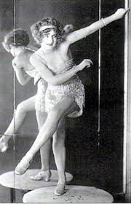
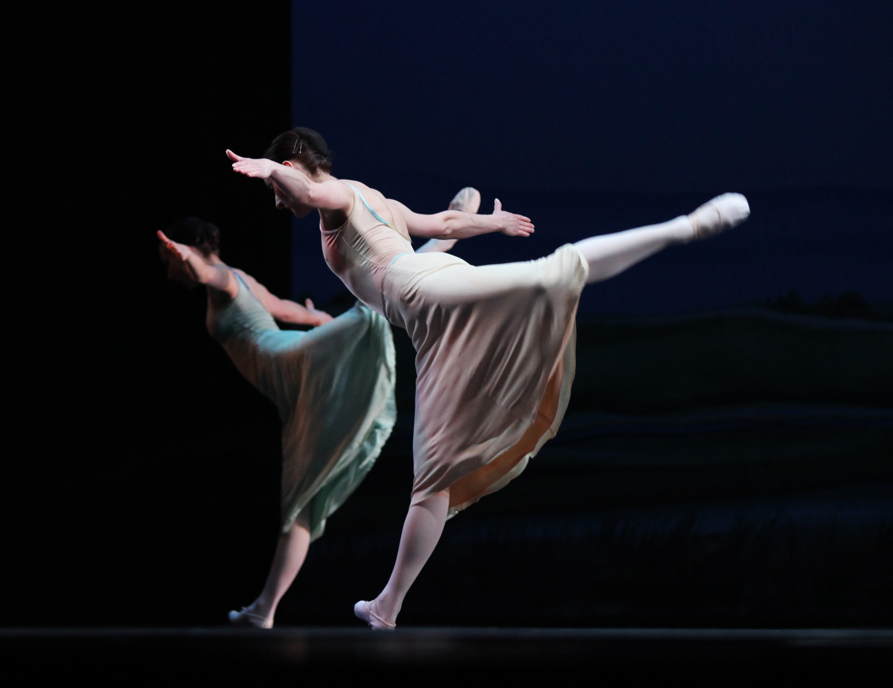
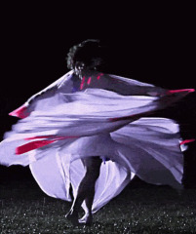
Inspired generations to come
Roaring 20’s
Modern Dance
Recreation

