Slide 1
Spiritual
Art
Foundation
Nuo

Slide 2
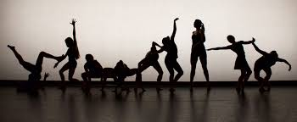
WHO ARE WE
WHAT DO WE DO
VIDEO
SPIRITUAL DANCE
PROJECT

Slide 3
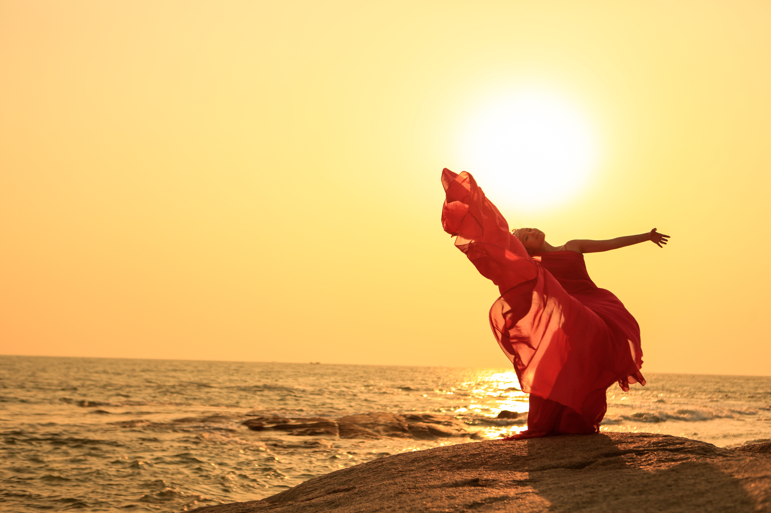
Nuo An
Dance Innovator | Choreographer | Dance Therapist
Founder, director and the first Spiritual dance artist of the Nuo Spiritual Art Foundation.
She initiates the new dance form
--- Spiritual Dance Art: integrating the Authentic Movement skills from dance movement therapy, while integrating Ballet and Modern Dance skills from professional dance training. Otherwise, inside principles from zan and Taoist philosophy.
With 35 dance career life worked with four universities, companies and cooperation in different art forms, she drives her passion to develop new stage with her mission and goal.

Slide 4
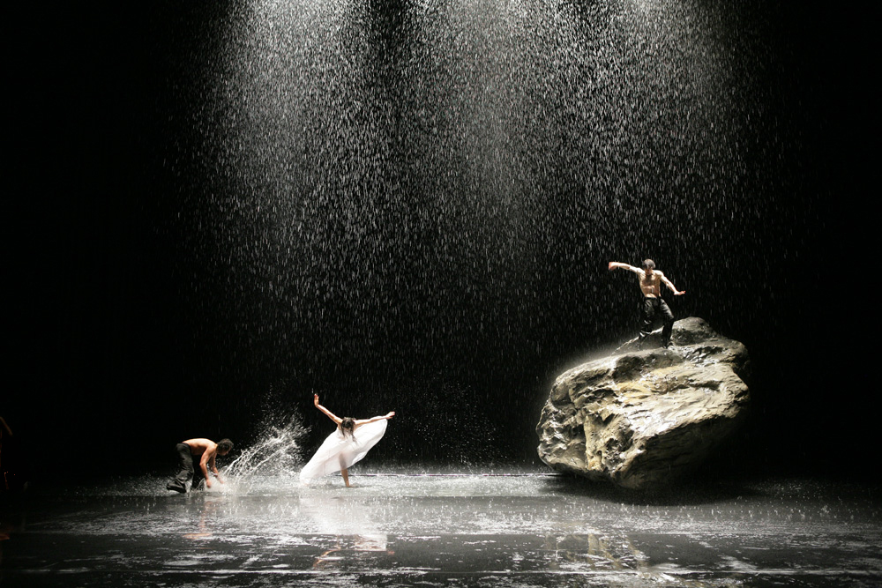
Who are We
The Nuo Spiritual Art Foundation supports US-registered nonprofit art institutions in their development of art creation . We believe that art is the source, the essence and the building blocks of life. We also believe that the meaning of life can be derived and discovered through the pursuit of fine art.
The foundation’s creative direction focuses on the convergence of real life phenomena involving the fields of nature, environmental protection, healing, faith, science etc. We love to work with all life .
Nuo Spiritual Art Foundation is the spiritual home for artists.

Slide 5
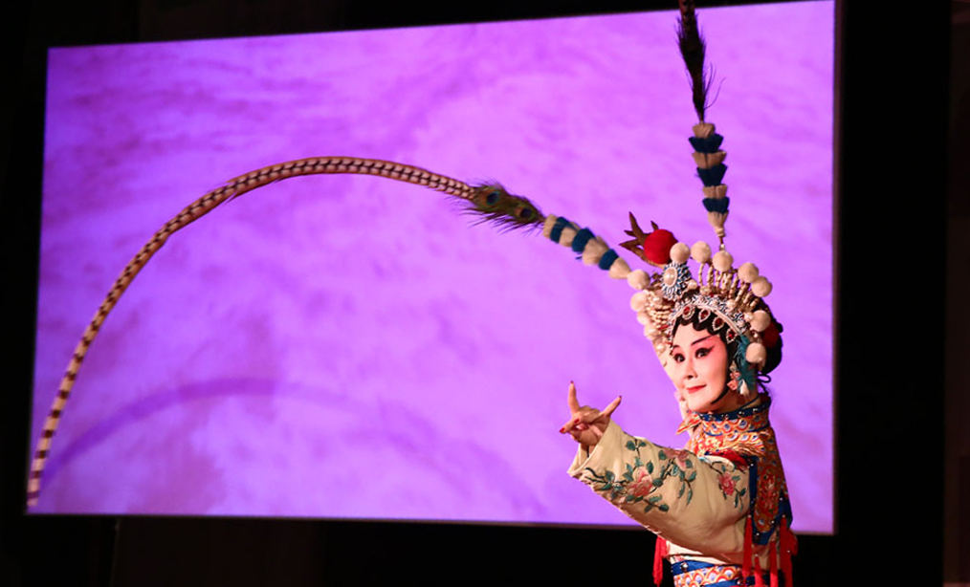
Nuo Spiritual Art Foundation concerns for all life, discovering aesthetic value in precious life we live. The first inspiration of Spiritual Art is originated from dance, the dynamic moved that regards to temperament and spiritual culture.

Slide 6
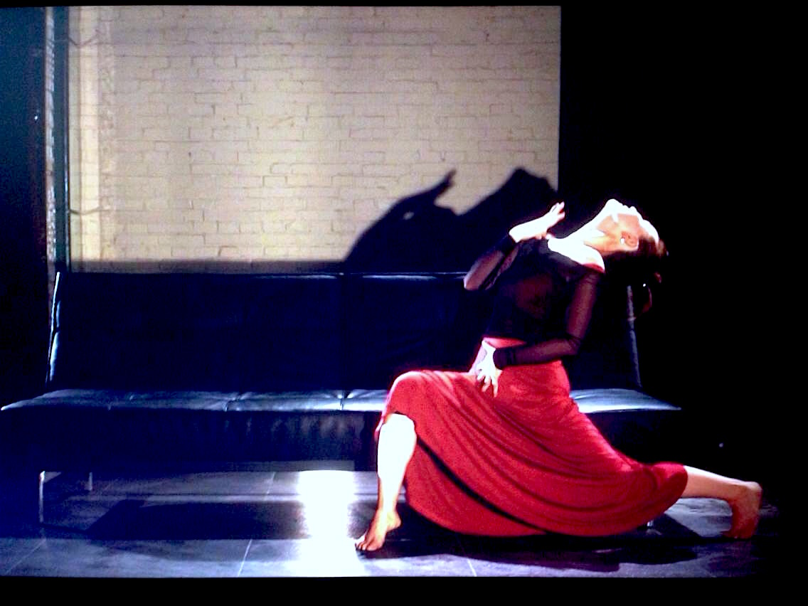
【What do we do】
Currently, Nuo Spiritual Art Foundation pays attention to develop the first spiritual dance project. This project will present culture of Eastern and Western aesthetic, culture diversity, even conflict and strive to express fusion. Dance art, as the unique language, delivers choregrapher’s thinking, views and solution with a philosophy attitude.

Slide 7
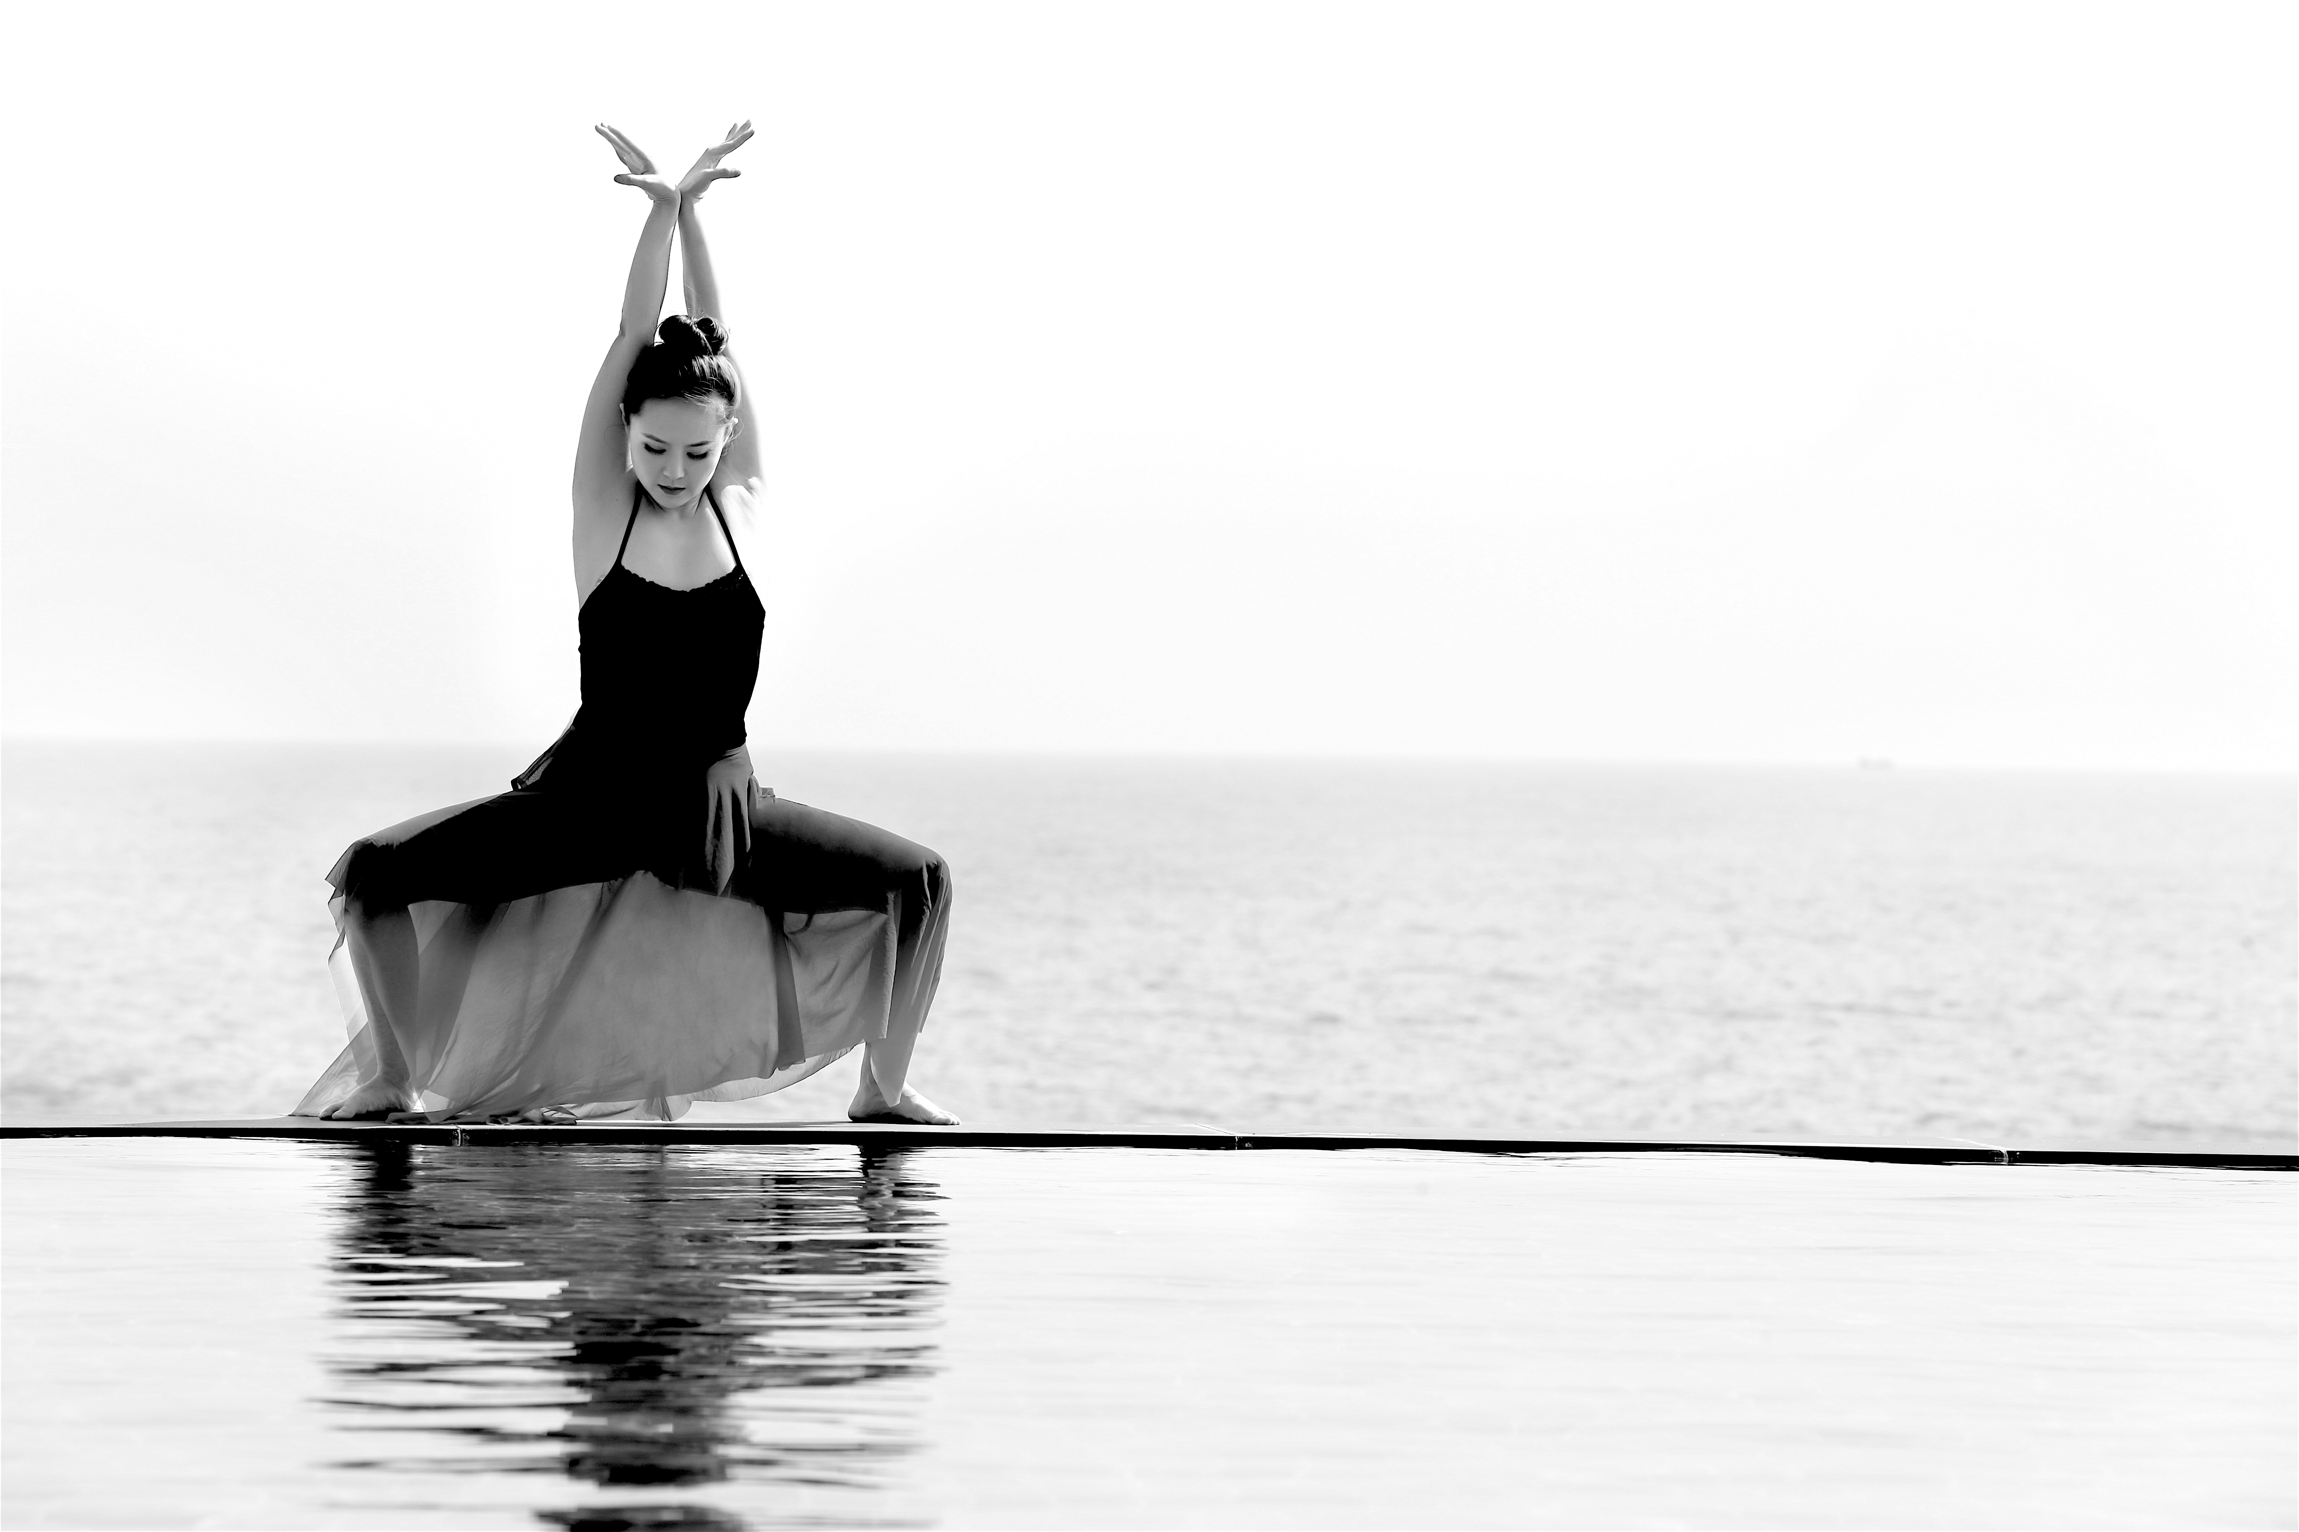
【Project Uniqueness】
Spiritual Dance is an essence pursuing internal motivation that is derived to the Authentic Movement skill by Dance Movement Therapy. It integrates Ballet and Modern dance skills as the outside ( body training). In and out, soul and body, interact with each other, form the new dance form. This project, first art work, discovers culture.

Slide 8
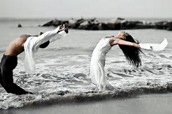
Thank You
Website:
Nuospiritualart.org
Welcome
Communication

