Slide 2
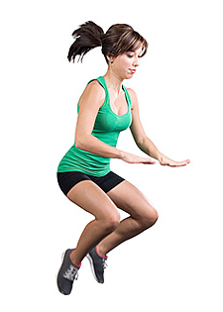
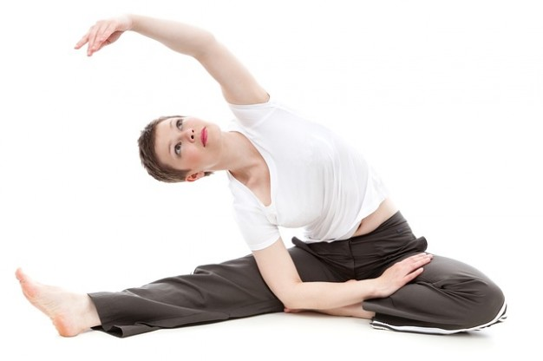
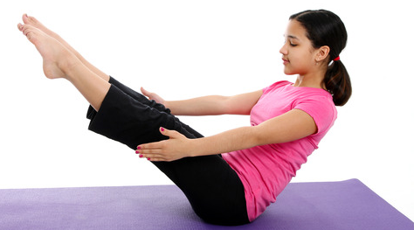
Introduction
Fitness has become mandatory in daily life in particular to dancers all over the globe.
The stamina level for dancers in yesteryear were remarkable just by practicing charis & karanas for warm ups but in recent times we have seen the want of fitness due to indulge in various activities.

Slide 3
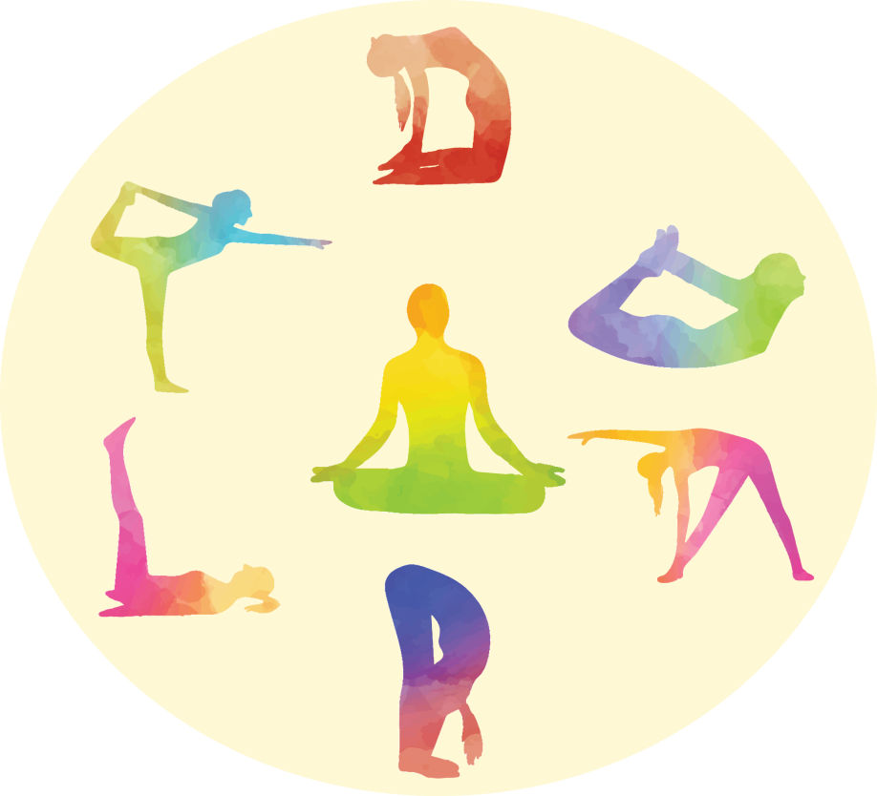
Fitness Components for Dancers
Speed
Strength
Endurance
Flexibility
Coordination & agility
Speed strength endurance flexibility coordination & agility are the major components for dancers.

Slide 4
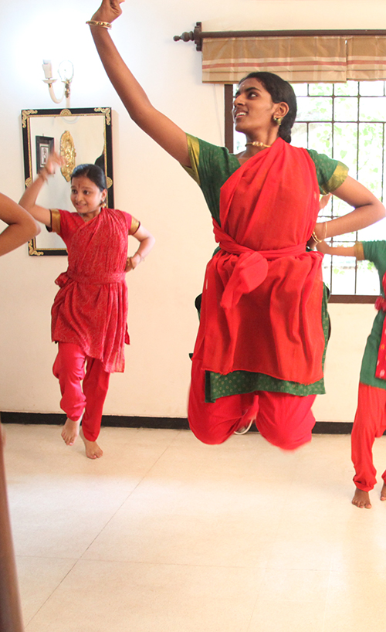
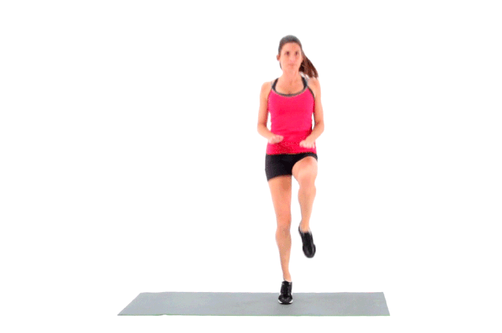
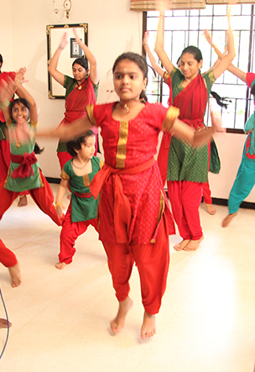
Speed
Speed dancing according to the rhythmic beats to slow medium fast is dancers speed.

Slide 5

Speed

Slide 6
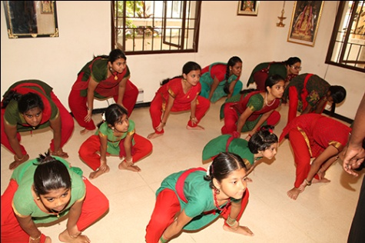
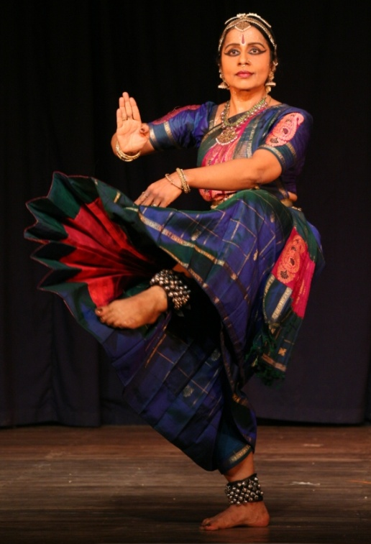

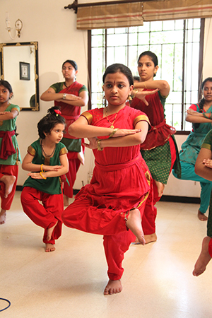
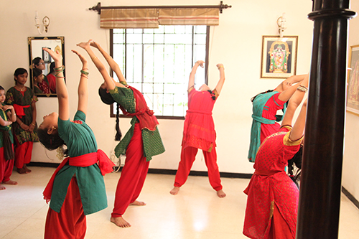
Strength
This is both static & dynamic. Static is rendering poses & dynamic is dancing to different patterns.
Static

Slide 7
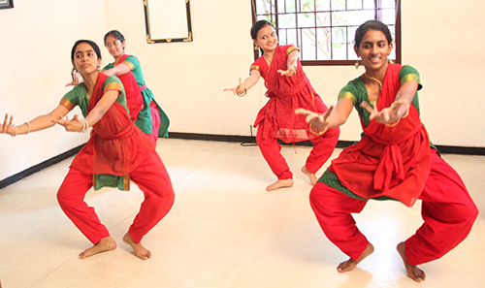
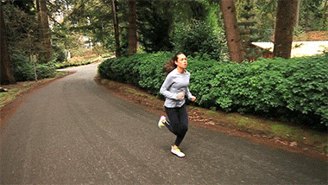
Endurance
Rendering a full length dance performance without fatigue for about 75 minutes to 90 minutes.

Slide 8
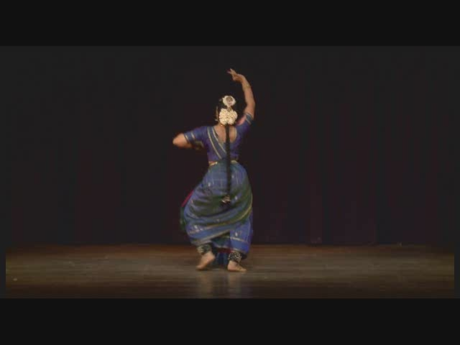
Endurance

Slide 9
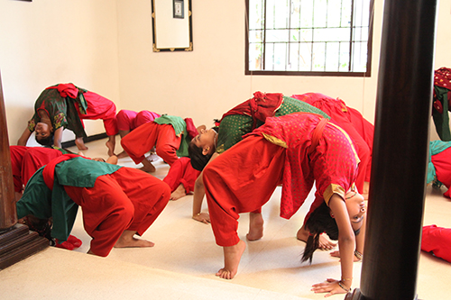
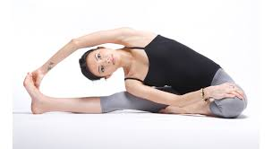
Flexibility
This lends grace to dance while completing a movement

Slide 10
Flexibility

Slide 11
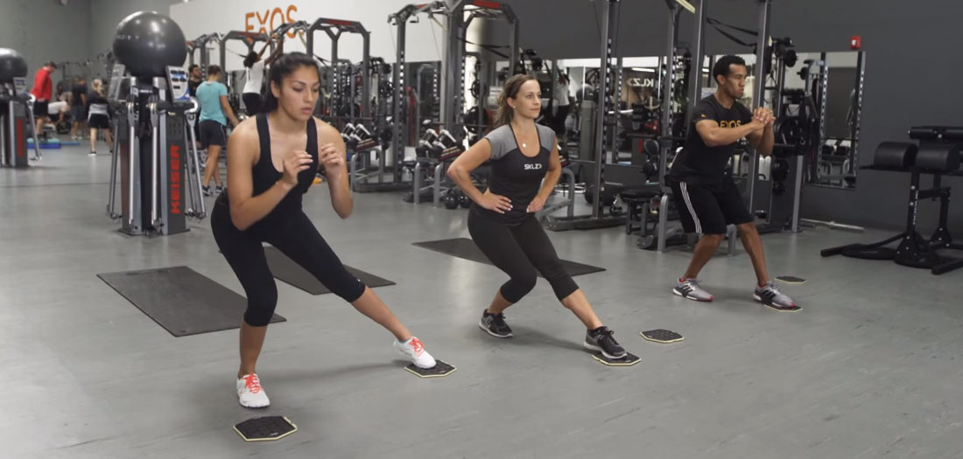
Agility
Having a firm footwork dancing effortlessly covering the space is agility in dance.

Slide 12

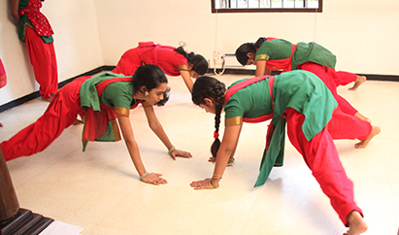
Coordination
Is the blend of footwork & facial

Slide 13
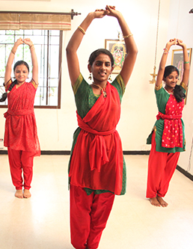
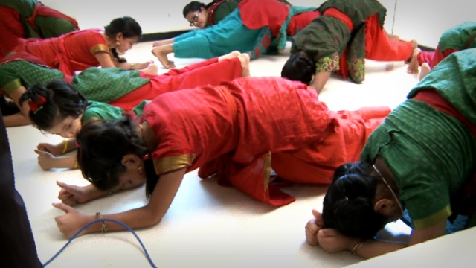
Development of Dance Skills through fitness
Having done all the warm ups & essentials during rehearsals we go on to tone the tight & weak muscles in order to polish the skill of the dancer.
Warm ups are to be done 5 mts before the class/rehearsal/practice...whole body stretches..

Slide 14
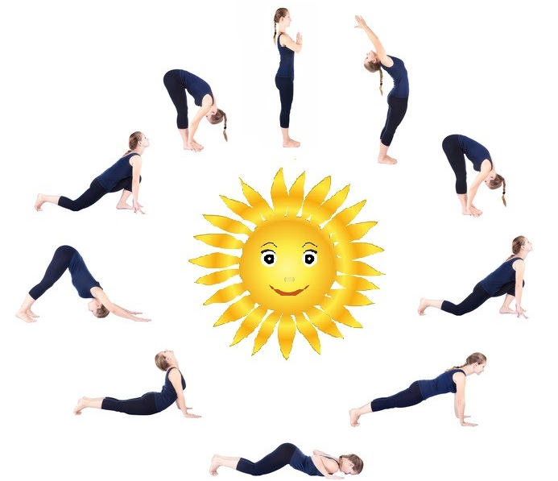
Development of Dance Skills through fitness
The following are the various forms of Fit to Dance:
Yoga
Bare foot
Hiit
Dance functional
Strength Traning
Aqua aerobics etc

Slide 15
Benefits
Avoid injuries improved performances age no bar
Boosted energy
High level of confidence
Feel & look fit & young
Relaxed physical & mental stature
Effective physiological & anatomical changes.
Reducing stress
Strengthen the bone and joints
Increasing aerobic and anaerobic movements

Slide 16
Conclusion
It is very well proven fact after a survey by different dance researchers & institutes like ACSM, ACE, YMCA, EBFA etc fitness is the core to dance.

Slide 17
Conclusion
MY Heartfelt gratitude to 50 CID –Athens Greece, Guru Srekala Bharath and Thejas School of performing arts, Chennai, India

